Slide 1


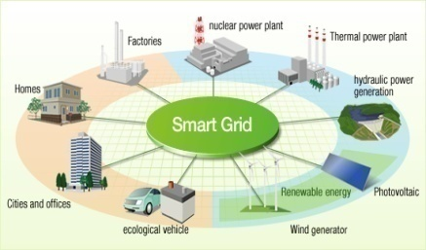

Fast-tripping Protection Schemes for DC Microgrids
Ali Bidram
University of New Mexico
January 21, 2022

Slide 2
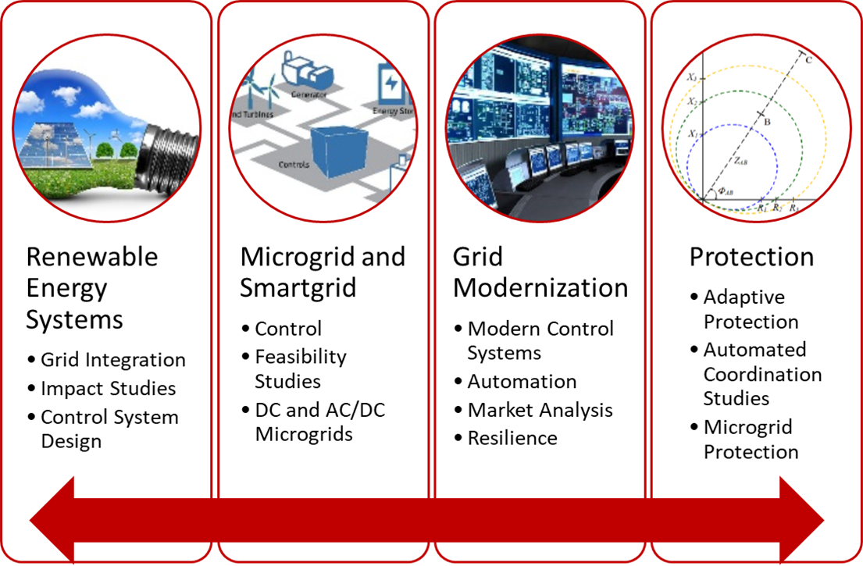
Power and Energy Program at UNM
A multidisciplinary research program working on multiple aspects of society's energy needs and networked systems:
power system control and protection,
microgrid and smart grid design and operation,
integration of distributed energy resources, Power Electronics, Storage and Electric Vehicles,
novel photovoltaics (PV) materials for better solar cells.

Slide 3
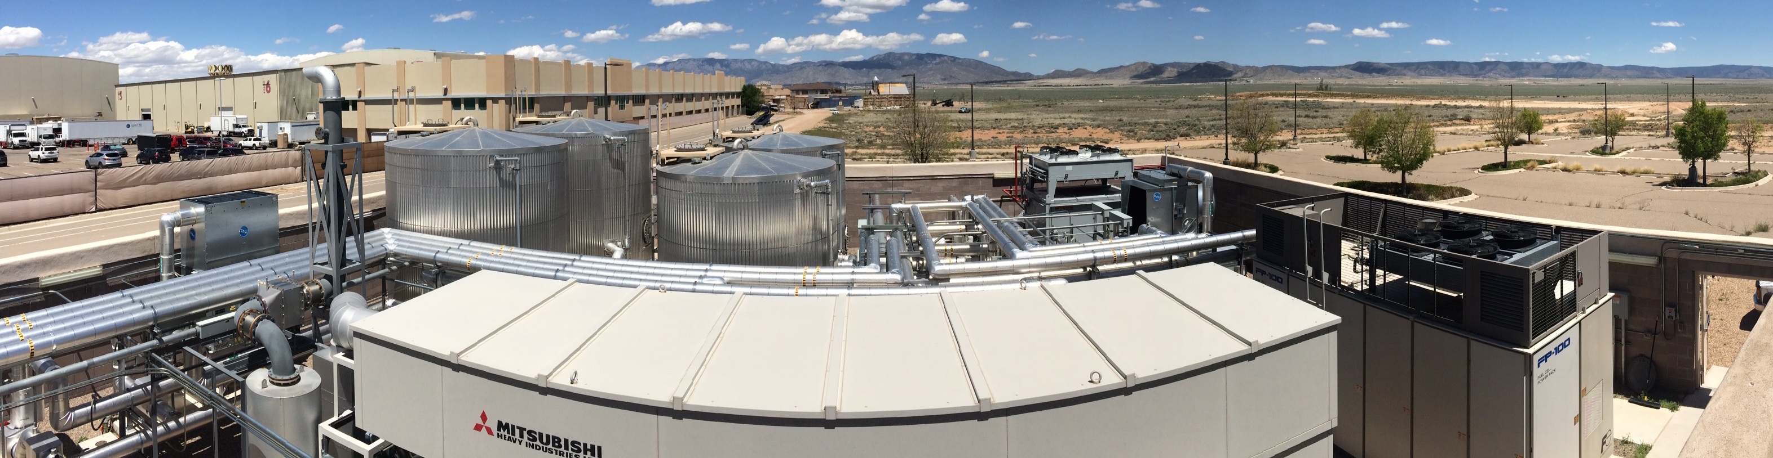
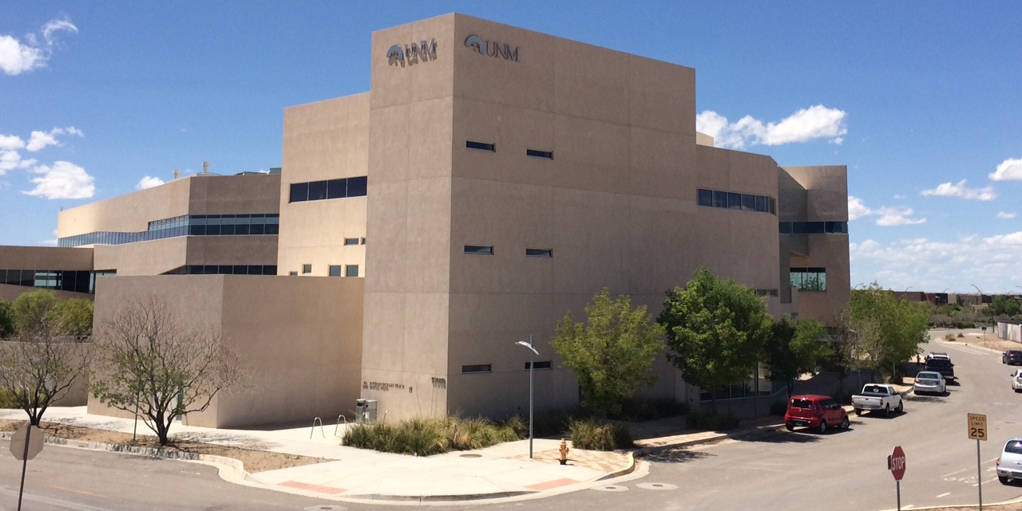
UNM Microgrid
PV system (50kW)
Lead-acid battery energy storage system (50kW/90kWh)
Natural Gas generator (240kW)
Fuel Cell (80kW)
hot and cold thermal storage, and an absorption chiller.

Slide 4
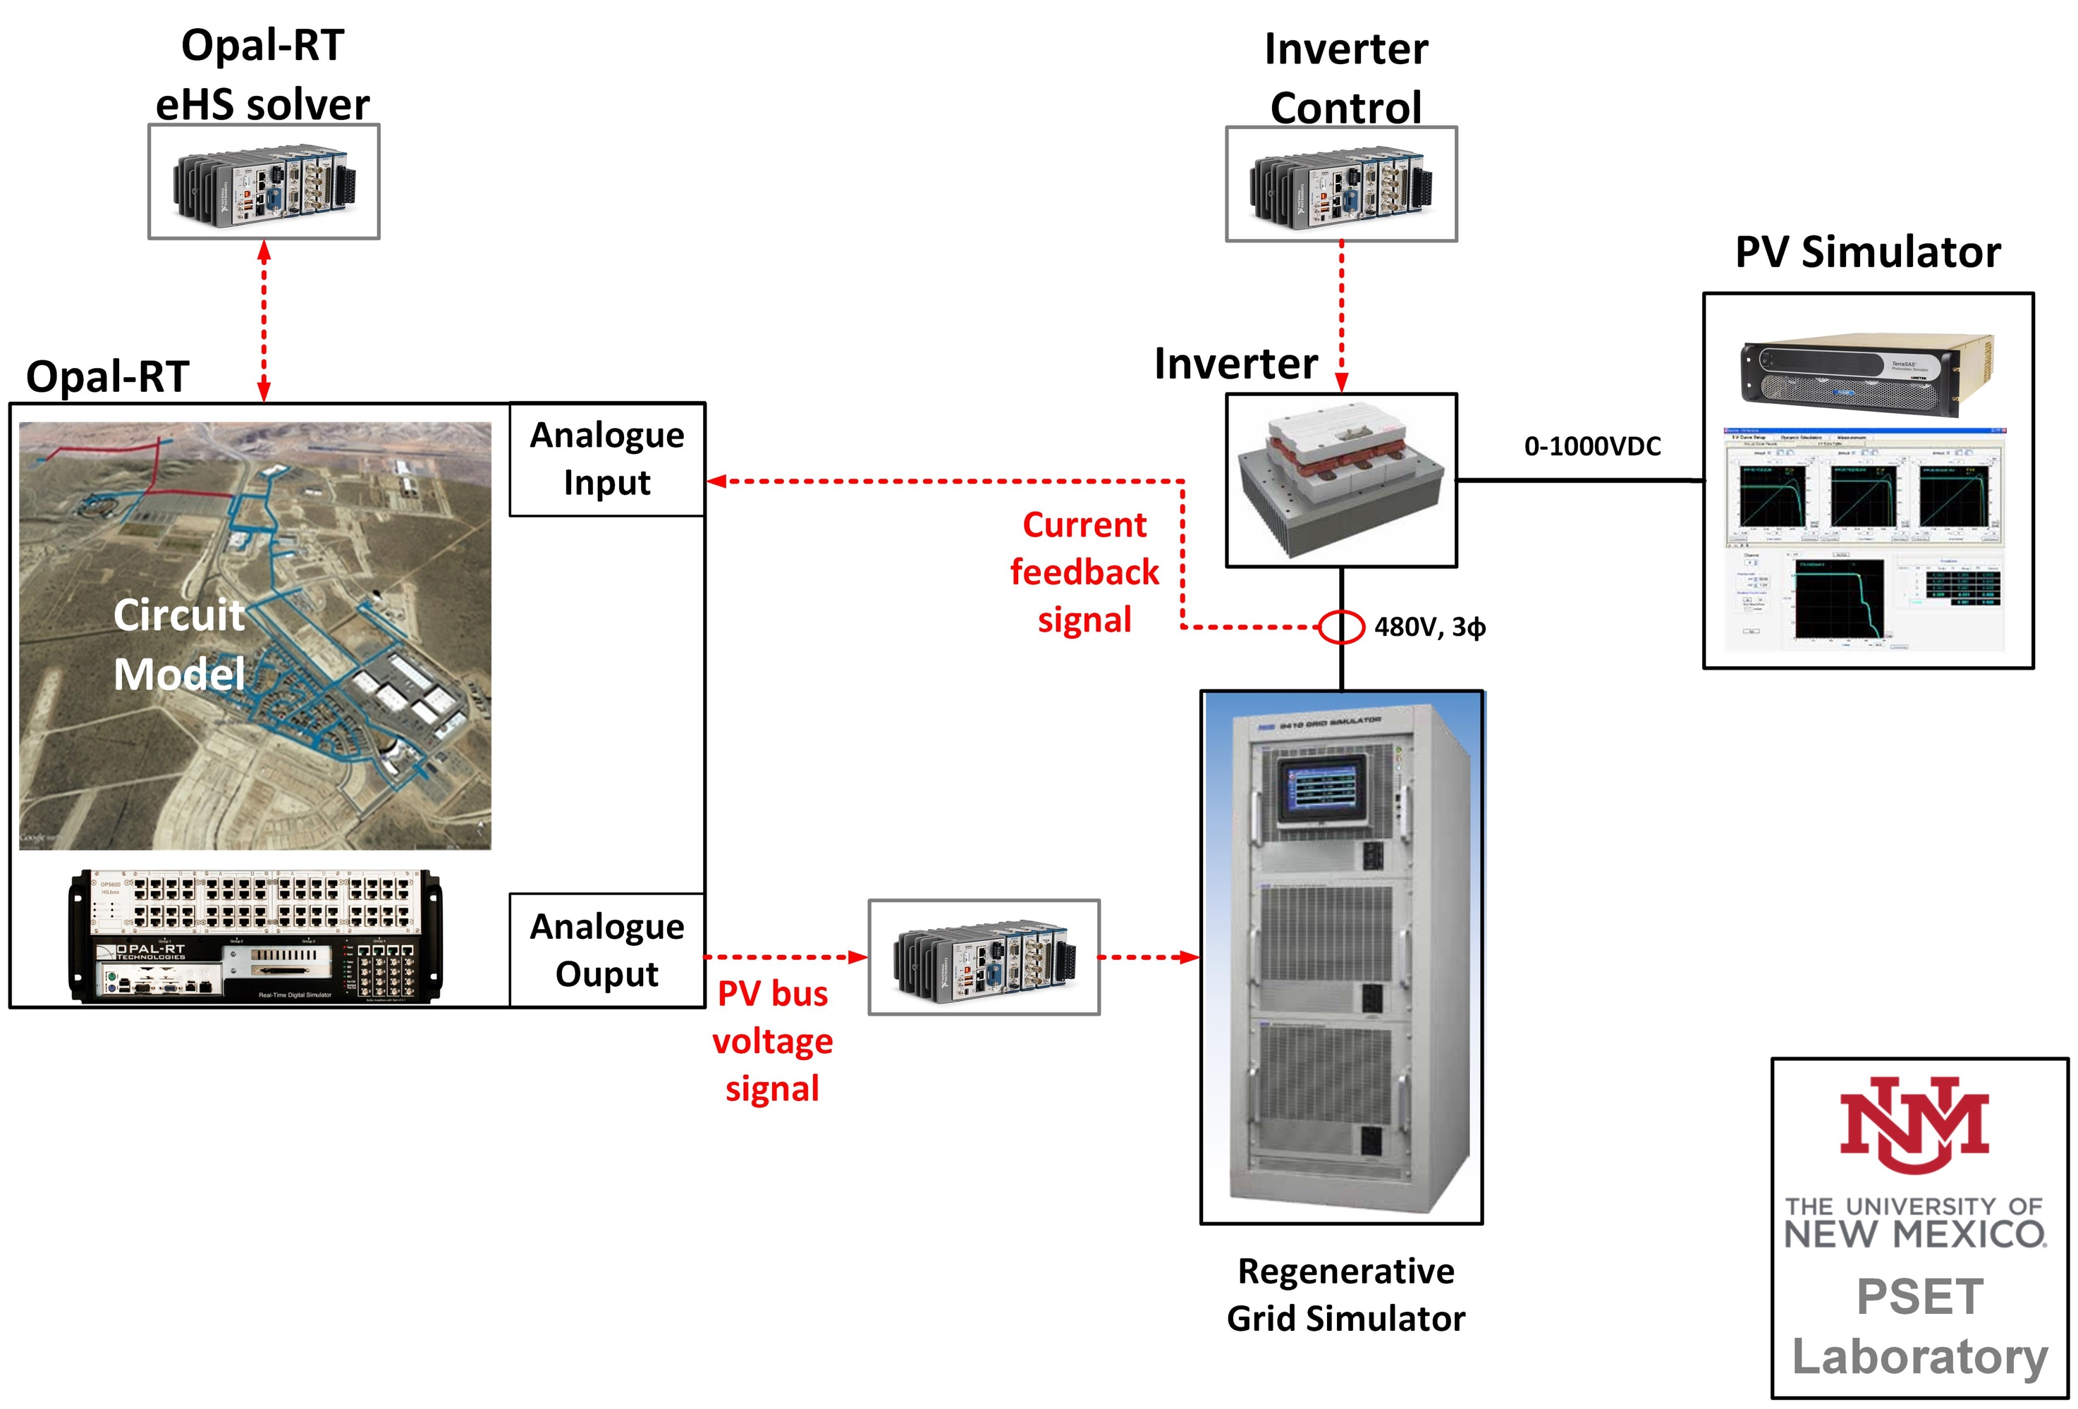
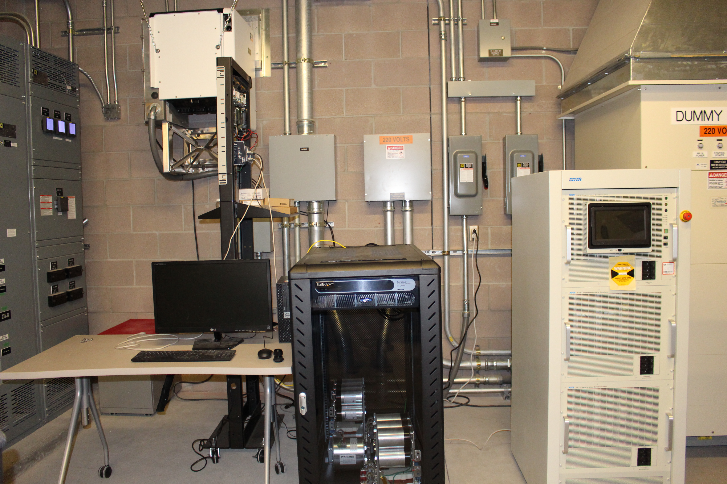
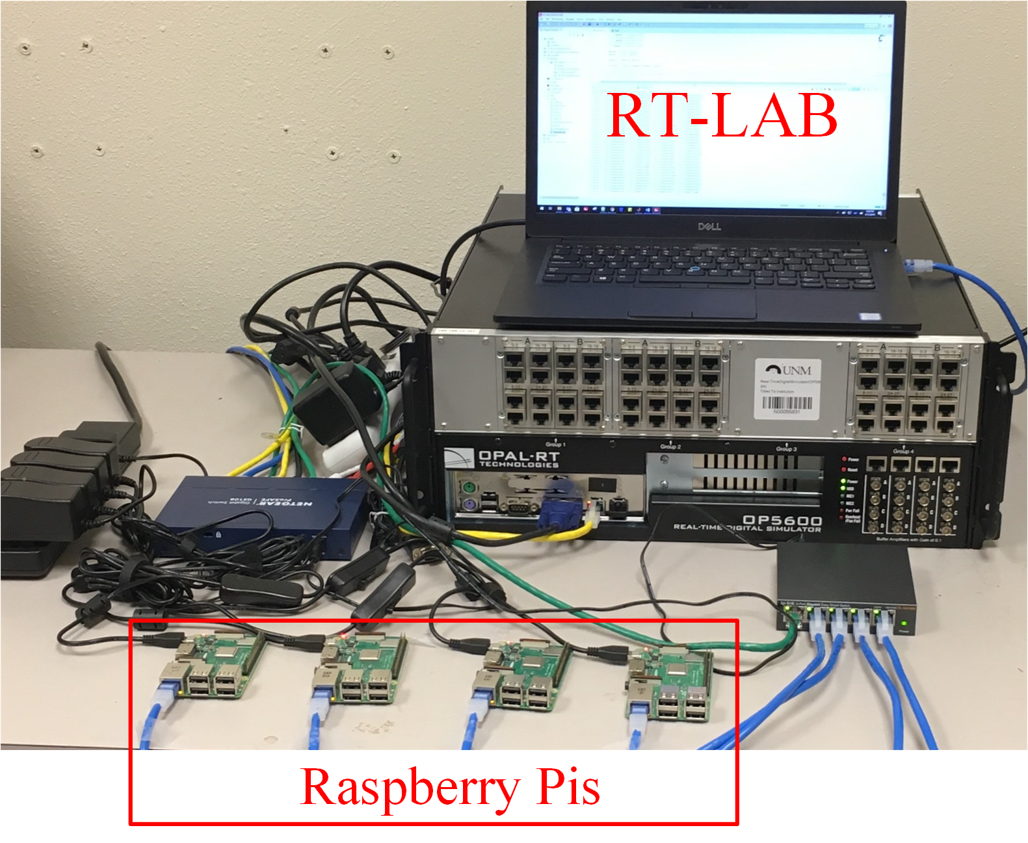
PSET Laboratory
Power Systems Emerging Technologies (PSET) lab:
Power and Control Hardware-in-the-Loop (HIL) Testbed

Slide 5
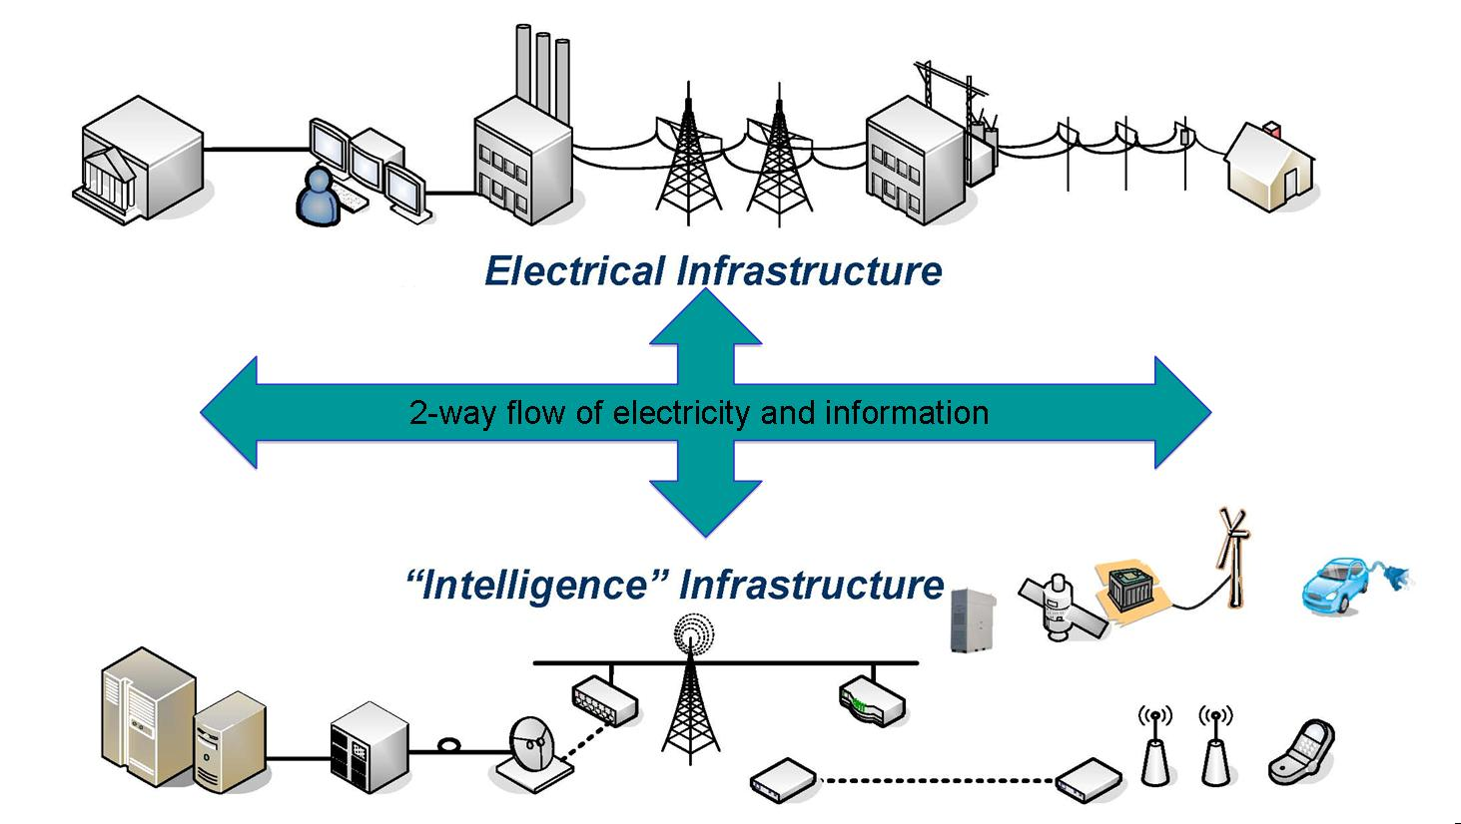



Introduction to smartgrids
Smartgrid refers to a class of technology that modernizes utility electricity delivery systems using computer-based remote control and automation.
Reliability
Sustainability
Efficiency

Slide 6
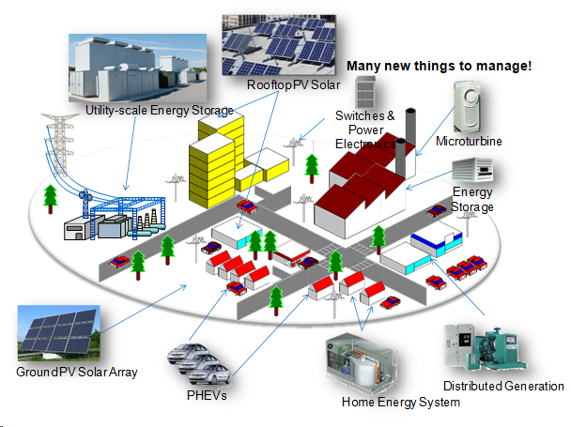
What is a microgrid?
Department of Energy:
Microgrid, as the main building block of smartgrids, is a group of interconnected loads and distributed energy resources.
Microgrid has the ability to
work in both grid-connected
and islanded modes.
Microgrid applications:
Rural plants.
Business buildings, hospitals,
and factories
Forward operating bases
Microgrid types:
AC Microgrids
DC Microgrids:
DC microgrids render increased efficiency compared to their AC counterparts and flexibility for the integration of DC power sources (e.g., photovoltaic and battery energy storage systems).
Photo from: http://www.horizonenergygroup.com

Slide 7
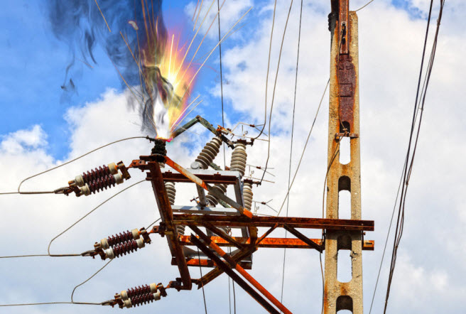
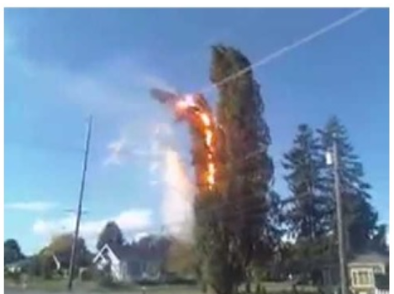
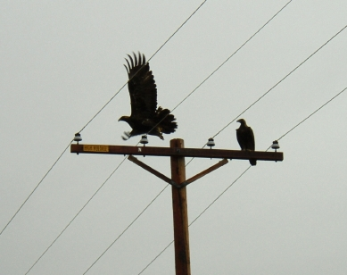
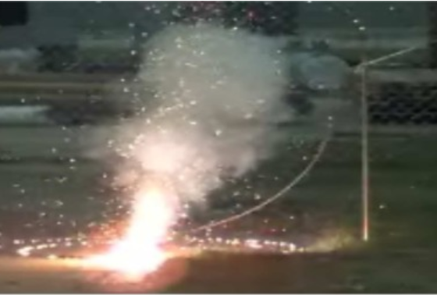
Power System Protection
Power system protection’s task is to detect and isolates faults (short circuits) in the system.

Slide 8
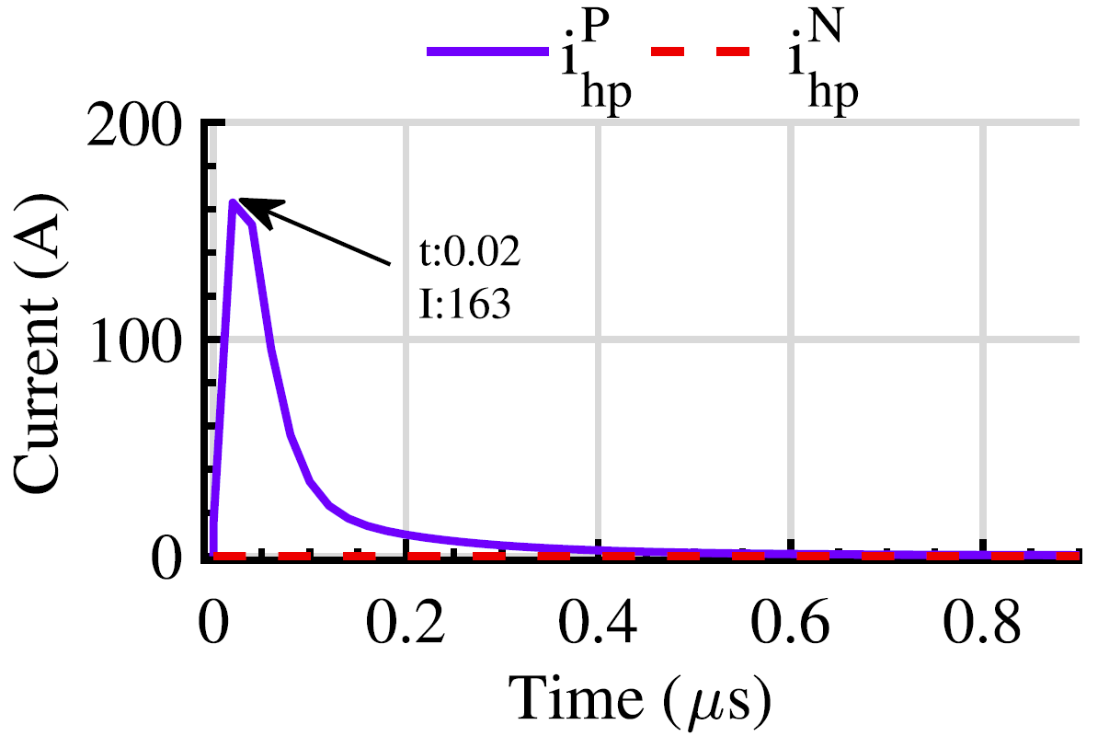
Protection Challenges in DC Microgrids
DC systems fault signature
The signature of dc fault currents is their very high magnitude with the peak usually attained within a couple of milliseconds after the onset of a fault:
Can damage IGBT switches in converters
IGBTs are blocked when the current is largely above their thermal inertia
Blocked IGBT → Losing controllability over the converter

Slide 9
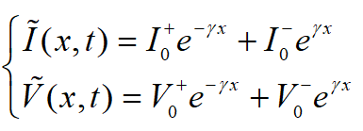
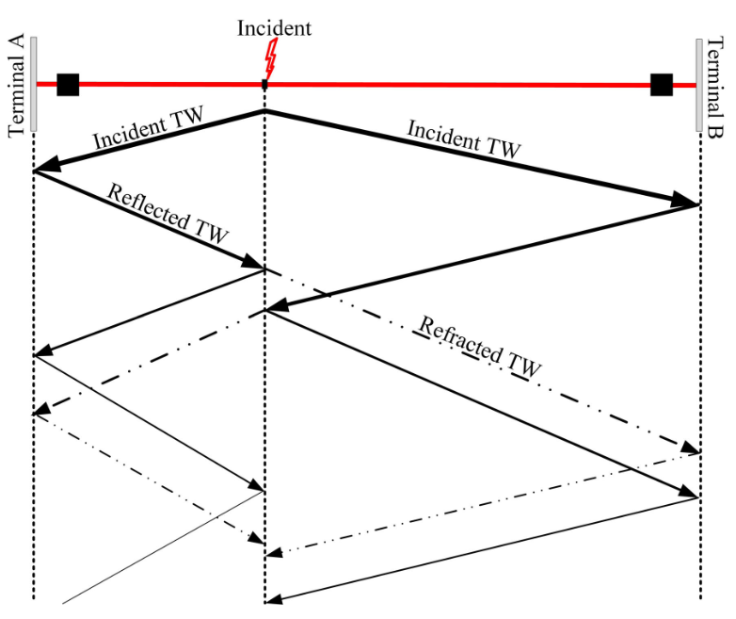
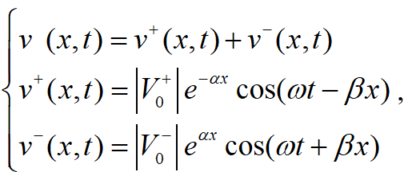
Travelling Waves
TWs are electromagnetic waves propagated along the power system equipment such as lines or cables when a disturbance (e.g., fault, lightning, switching, etc.) occurs

Slide 10
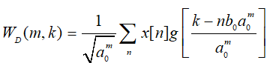
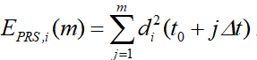
Multiresolution Analysis
In order to effectively construct wavelets over a wide frequency range, multiresolution analysis (MRA) is a practical approach for fully implementing the DWT.
Once the MRA based wavelet coefficients are identified, the Parseval’s theorem is used to calculate the energy corresponding to the identified coefficients

Slide 11
High-Frequency Fault Signatures in a DC system

Slide 12
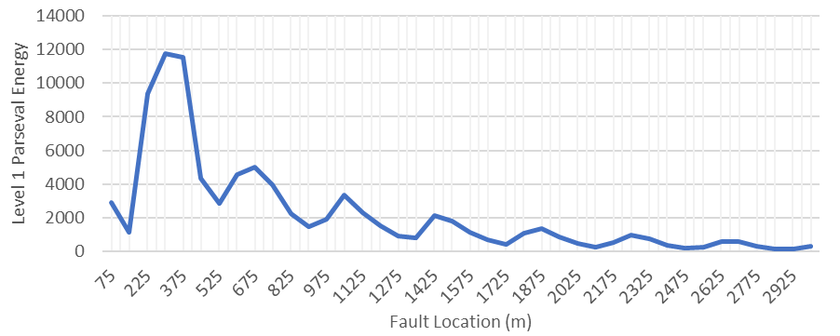
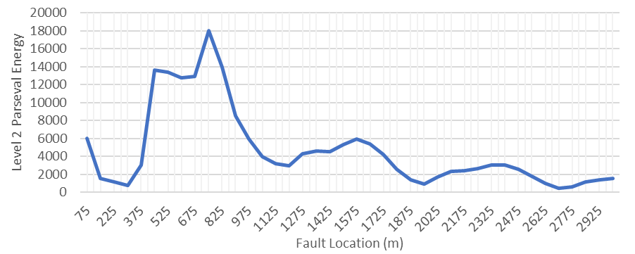
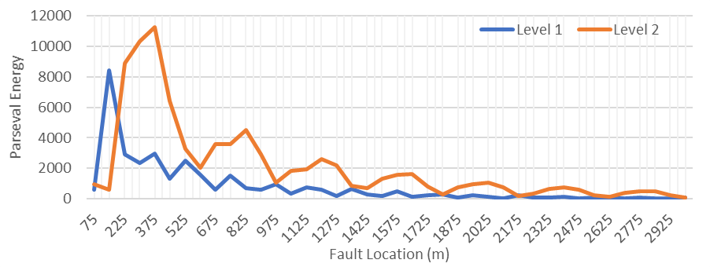
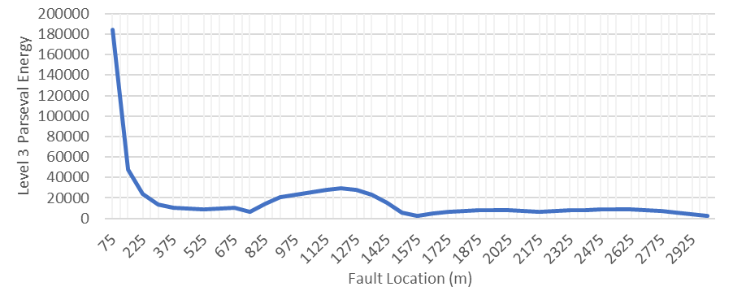
High-Frequency Fault Signatures in a DC system
2 MHz Sampling Frequency
1 MHz Sampling Frequency

Slide 13
Pole to Ground Faults

Slide 14
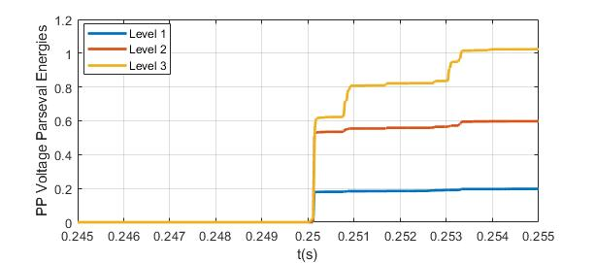
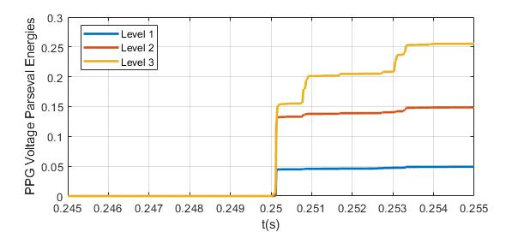
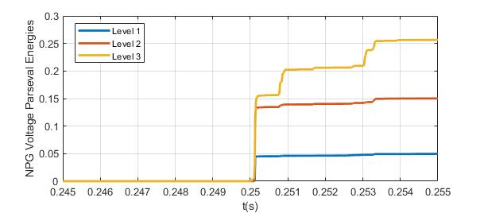
Pole to Pole Faults
Impact of PP fault on pole to pole and pole to ground voltages’ Parseval energy

Slide 15
Fault Detection and Location Algorithm
Fault detection and location algorithm
Fault classification using SVM
Fault location using Gaussian Process

Slide 16
Verification Results
Verification results
Fault Location Estimation Error
Cable | Bolted PP | Resistive PP | Bolted PG | Resistive PG
C1 | 4.9% | 3.6% | 2.5% | 4.1%
C2 | 5.1% | 2.9% | 3.9% | 1.1%
C3 | 4.7% | 6.1% | 4% | 2.7%
C4 | 1.1% | 0.4% | 2.1% | 0.2%
C5 | 6.3% | 0.6% | 0.8% | 0.6%
C6 | 5.3% | 4.8% | 6.2% | 3.4%
C4 bolted PP faults
C4 resistive PP faults
C4 bolted PG faults
C4 resistive PG faults

Slide 17


